Slide 1
How to Return a Kindle eBook
MC-NPL Computer Lab
www.mc-npl.org
Revised:
10/19/2015
By Michael Angstadt

Slide 2
What you’ll need
A computer with Internet access.
Your Amazon account login credentials.

Slide 3
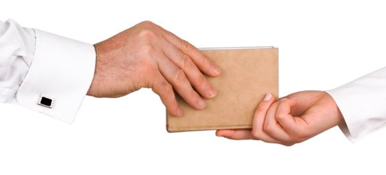
Will I be fined if I don’t return an eBook on time, like a regular library book?
No. Your eBook will be automatically returned once its load period expires.
Returning an eBook early lets the next person that’s waiting for it check it out sooner.

Slide 4
1. Go to www.amazon.com. If you are not already signed in, click the “Sign in” button to sign into your Amazon account.

Slide 5
2. Once signed in, point to “Your Account” at the top of the screen. A pop-up menu will appear. Then, click on “Manage Your Content and Devices” from the pop-up menu.

Slide 6
3. All of your checked-out Kindle books will be displayed. Click the “…” button next to the book you want to return.

Slide 7
4. Click “Return this book” in the pop-up menu that appears.

Slide 8
5. Click “Yes” at the confirmation dialog.

Slide 9
More Information
For more information on library eBooks and audiobooks, please see our eBook Help page:
www.mc-npl.org/ebook-help

